Slide 1
SHIFT’s Community Selection Model
By Benjamin AJIBADE
SHIFT Data Analytics

Slide 2
Community Selection Model
Community identification and prioritization is very much a core part of SHIFT’s strategy. Nigeria as a nation is highly populated, over 774 LGAs and thousands of local communities.
Visiting everyone of these communities is unrealistic in the process of enabling transformative leaders and improving civic participation in this communities .
Therefore it is very important to make drill down selection to a realistic number that we can focus our resources on.
Two factors that is highly sacrosanct in our decision making process is Vote casting and Candidate to support.
“if you cant be voted for you cant win, invariably; you cant rule”

Slide 3
Data Driven Approach
3-level Breakdown
36 States
Drill down 36 states to a moderately feasible number as to first prioritize in the 3rd quarter of '19.
774 Local Governments
From selected states, the selection model gives an insight to the LGA to be selected
8000+ communities
from the identified LGAs , it would be easier to get a deeper insight into this communities and selection more easier
This is taken from a data-driven approach.
The first being a 3-level breakdown
Narrowing down the states to focus on
Narrowing down the LGAs in the state selected
Streamlining communities even at the LGA level.

Slide 4
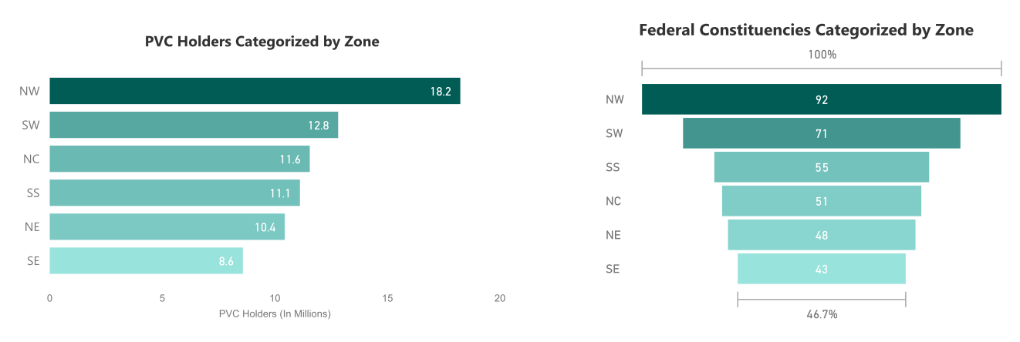
States to Focus
The selected states are from 6 geo political zones. They are selected based on 2 criteria
potential voters present and political power.
Obviously NW and SW are the best performing zones giving the potential voters and political representatives present.

Slide 5
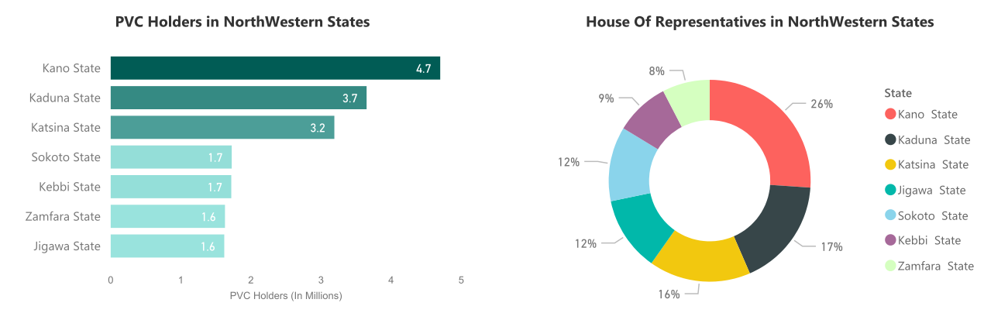
Prioritized States: North-West
The selected states here are
Kano
Kaduna
Katsina
These 3 states has approximately 11.6 million potential voters and 60% of the members of the house in the region. They are very decisive in the political activities.

Slide 6
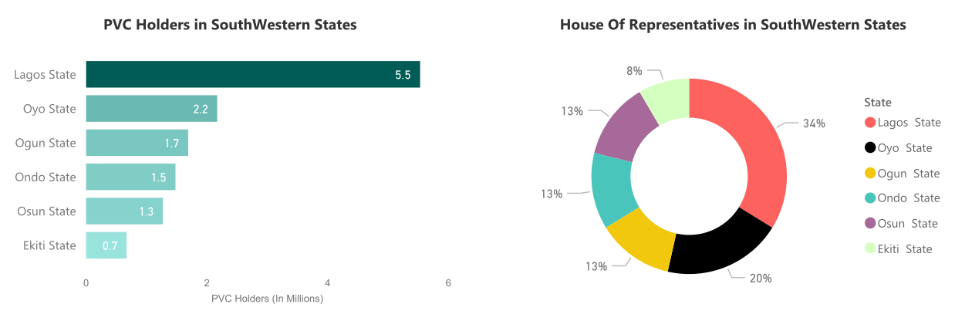
Prioritized States: South-West
The selected states here are
Lagos
Oyo
Ogun
Listed is according to priority. These 3 states currently has over 9.4 million potential voters. 54% of the members of the house in the region are from Oyo and Lagos alone . The first two are very decisive in the political activities in the region.

Slide 7
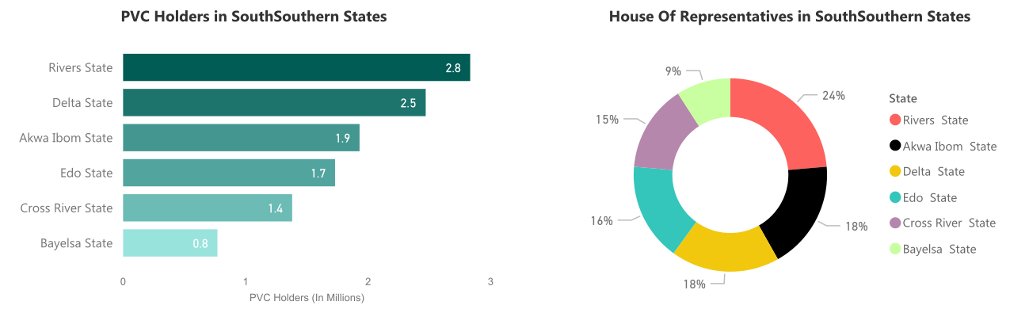
Prioritized States: South-South
The selected states are
Rivers
Delta
Akwa Ibom
Listed according to order of priority. Selected states currently boast of 7.2million eligible/potential voters. They have in combine 50% of the members of the house in the region.

Slide 8
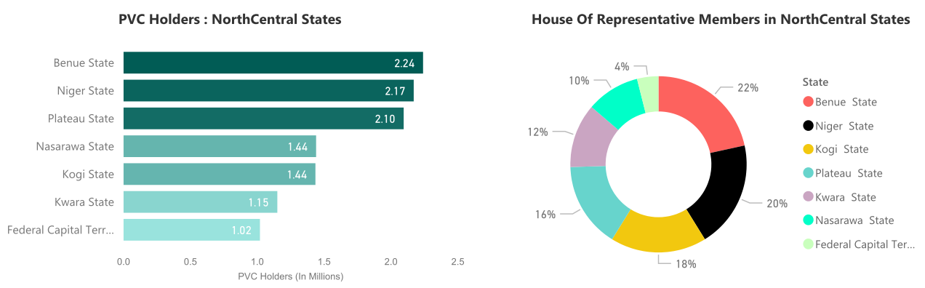
Prioritized States: North-central(NC)
NC comes next, the states identified are
Benue
Niger
Plateau
Although Kogi has a slightly higher percentage of pollical rep. over Plateau, I prioritize Plateau; as the state displayed just less than doubled the potential voters in Kogi. “And if you don’t Vote , you get governed by the wrong minds”
The 3 selected states has 6,5M potential voters that can be influenced, covering 58% of the political rep. of the zone in NASS.

Slide 9
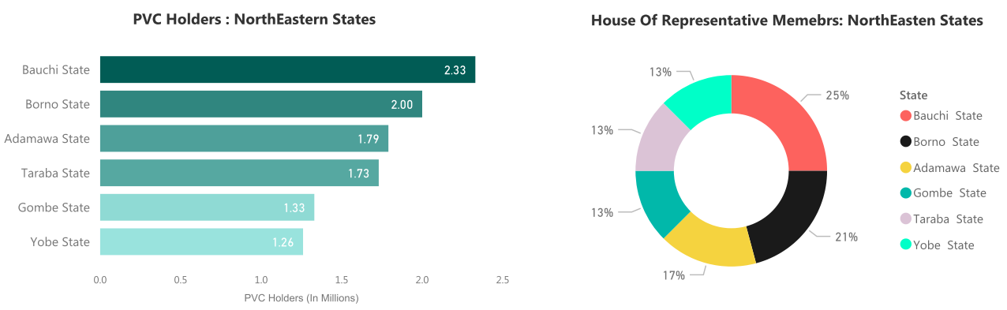
Prioritized States: North-East(NE)
The selected states are
Bauchi
Adamawa
Taraba
Selected states currently boast of over 5.8 million eligible voters. They have in combine 55% of the members of the house in the region. Borno is excluded because of security reason. Well, the NE states are very much under serious consideration based on security issues.

Slide 10
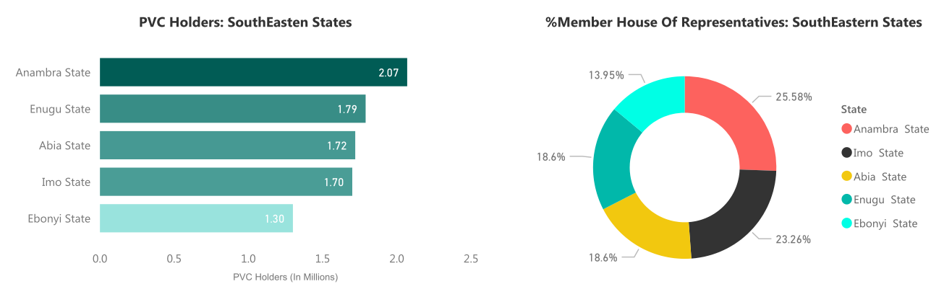
Prioritized States: South-East(SE)
The last prioritized zone is the SE. The selected states are
Anambra
Enugu
Imo
Selected states has of about 4.6 million eligible voters. They have in combine 68% of the members of the house in the region.

Slide 11
Based on feedback
Review from consummate professionals say
The potential voters criteria will not be sufficient enough in picking these states.
The highlighted stats varies directly with the population of the states i.e a low populated area/state would tend to have a low number of potential voters.
Lastly, all state selected should be subjected to a security-litmus test. No matter how it fits the critera if it fails the test, it should be deemed a no-go-area.
This would be done at community level as well to identify an environs that could be violent or dangerous for strangers.
SAFETY FIRST …..since it’s only the living that can make a change

Slide 12
Response
Reacting to the feedback
I am looking into stats such as voters turnout at state level which would be a more sufficient method in addition to the potential voters
And also looking into minority party power in each state

Slide 13
Identifying Local Government in Selected States
The states selection left us with 18 out of 36 states (excluding Abuja), but still with hundreds of LGAs which is also unrealistic to visit every one.
Selection at this level has to be very well considered.
Which bring us to a model , to help identify prospective communities that SHIFT’s message would be well suited to the inhabitants .
The model is driven by two important components
Community pillars defined by Dimensions and Indicators
Likelihood of voting: Historical voters turnout

Slide 14
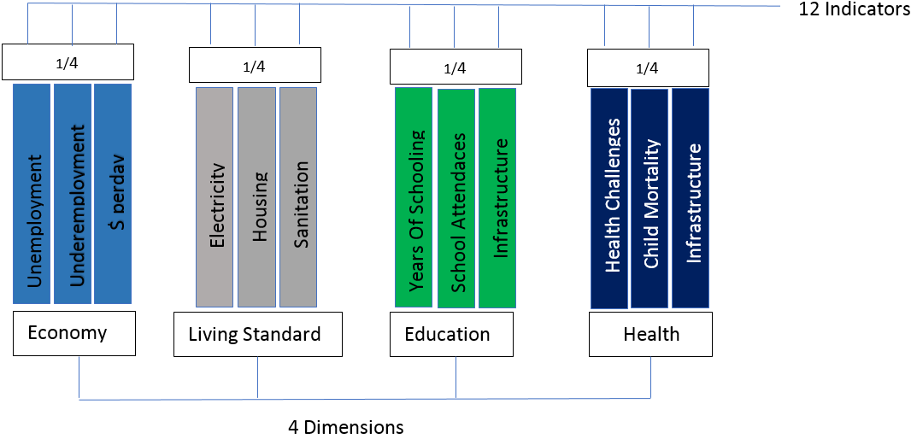
Community Weight
The fig. shows 12 indicators grouped into 4 dimensions. Its designed that each indicator will be 1/3 i.e 1 is the highest score while zero is the lowest.
The aggregate for the indicators for across all dimensions are placed over 4 where ¼ would be the highest. The total for the 4 dimensions is the weighted score, the highest being 4/4 .
For a community to have more than 50% or 0.5, then it must have been so bad across all dimensions. Scores below 33% are considered low.
NB: Having high score means the community is in poor shape.

Slide 15
Likelihood To Vote
Voting and potential to vote cannot be overemphasized in this process.
This is to predict community’s participation in upcoming election.
Historical data of voters in this community is needed.
Data far back as from 5 or more consecutive years.
An example is shown in fig. using Kwali and Kuje as an example. By getting insight into the trend we can predict the turn out factoring in the deviation +/-
NB: Data used are assumed and are not a real sampled data.

Slide 16
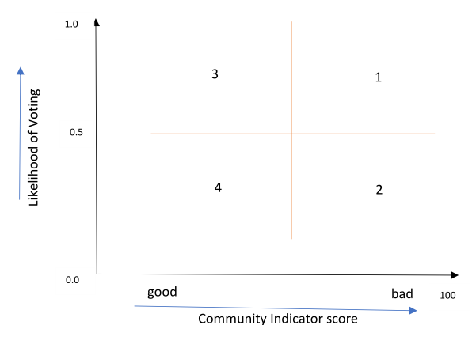
Visualize
Quadrant 1: Community that falls into this quadrant are of high priority during selection. Most times these types of communities are usually rural and they participate in the voting process
Quadrant 2: 2nd priority, although the likelihood of voting is low. They have got a weakness to exploit. Sensitize on how underprivileged they have been due to bad leadership. This can be used to influence their participation in voting process. The SHIFT care program can be instrumental as well.
Quadrant 3: this quadrant shows the type of community that has good standard of living, and as well as a high likelihood of voting. Not ideal (Rare but exist).
Quadrant 4: shows communities that have a good standard of living but very low turnout during elections.

Slide 17
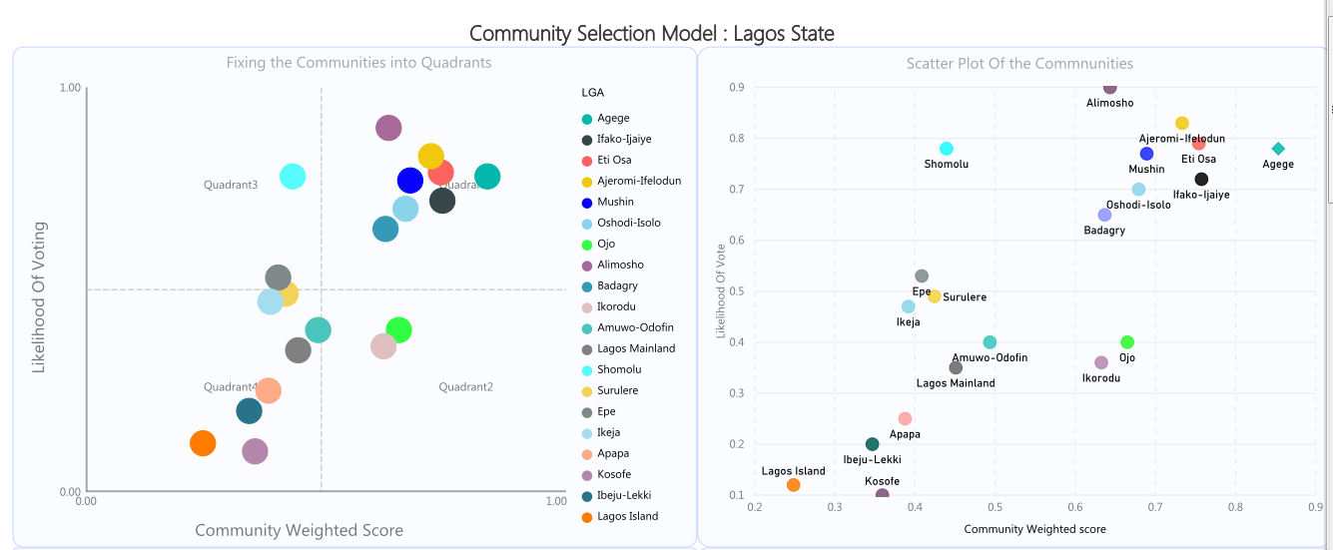
Lagos State as Case study

Slide 18
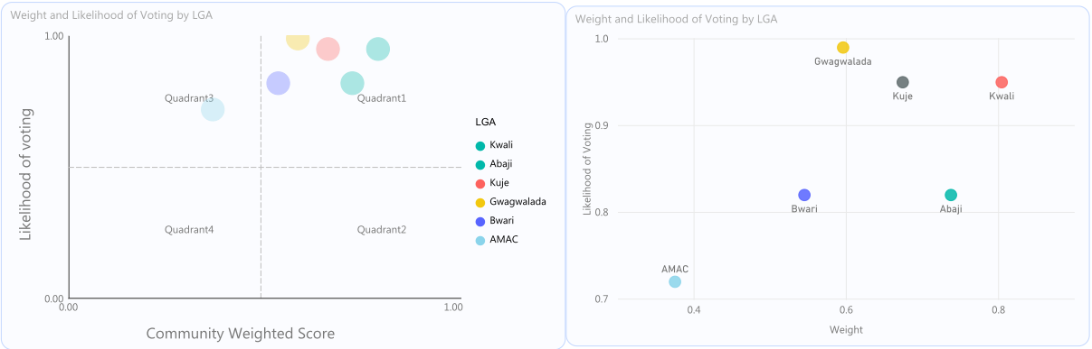
FCT Case

